Slide 1
“Pussy Riot”
NFT-Token

Slide 2

NFT-Token short definition
Founders
Essence of their work
Main idea:
-what is behind the start-up
-what prompted the start of the project
-moment of donation
Investors
Problems that were met

Slide 3
NFT-Token definition
Non-fungible token
Unique
Cannot be replaced with something else

Slide 4
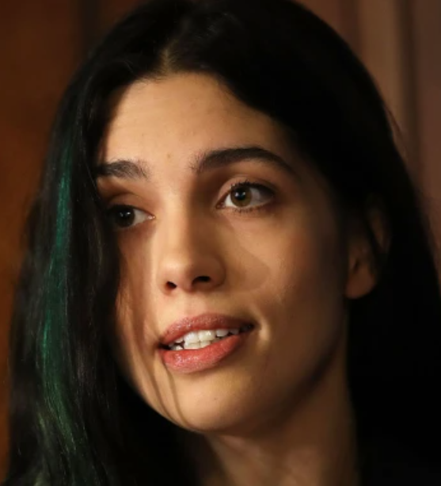
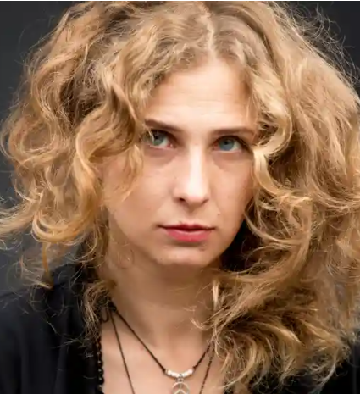
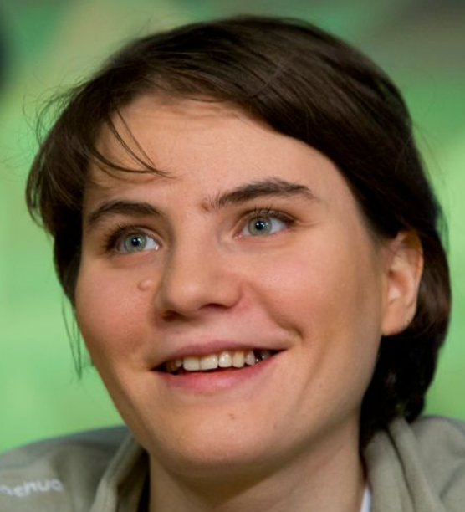
Nadezhda Tolokonnikova Maria Alyokhina Yekaterina Samutsevich

Slide 5
“This is the battle I picked—to bring more positivity, acceptance and democratic rights to the world. It doesn’t stop with Russia. We face systemic oppression, it’s a global issue” - N. Tolokonnikova

Slide 6
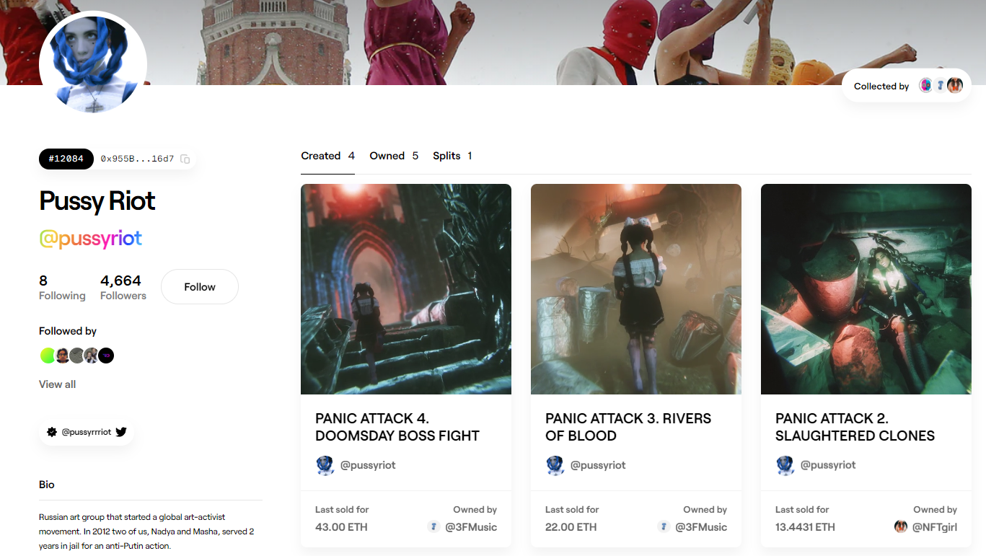
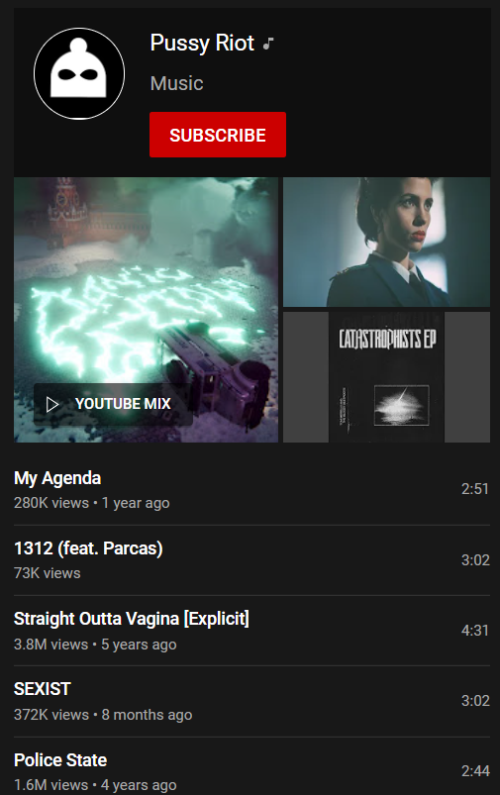
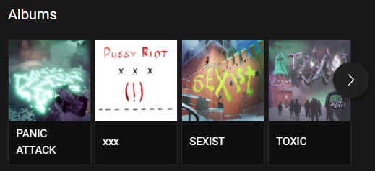
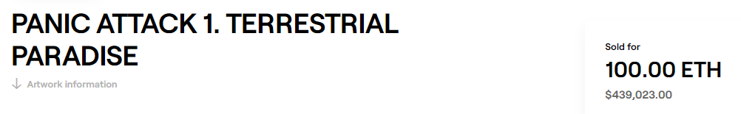
Examples of their work

Slide 7
“We can use NFTs to support good causes and communities, it’s a great thing to do, so I’m happy to be part of this” -Amir Soleymani

Slide 8
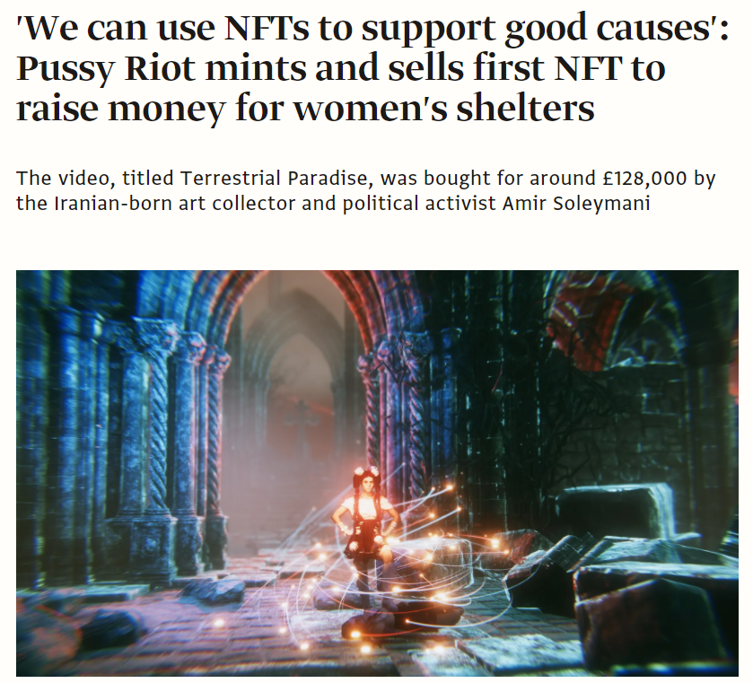
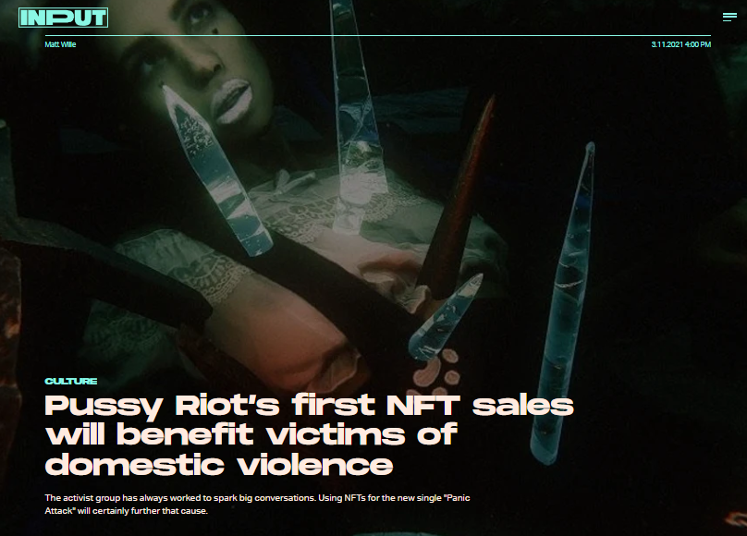

Slide 9
“If you are consistent with your work, you will find your family. In that sense, it reminds us of the activist community. For a few years, we were living mostly within the music and entertainment industry, but it feels like stagnating, it’s much more about your personal game. Now we’d love to be around people who want to change the world and be part of something bigger than that” - „Pussy Riot”

